Slide 1
SHSAT Question Corrections
[your name]
2025
This slideshow is split up into two categories: reading/writing and math. Make sure to group questions in its respective category. Each question you get wrong, fill out the categories on each slide using the information from that one question. Make a copy first!!

Slide 2

Reading/Writing Section
2025

Slide 3
[date or practice test #]
Question #_
Question Description:
My Answer:
Correct Answer:
Skill:
Why I Got It Wrong and Explain Correct Answer:

Slide 4
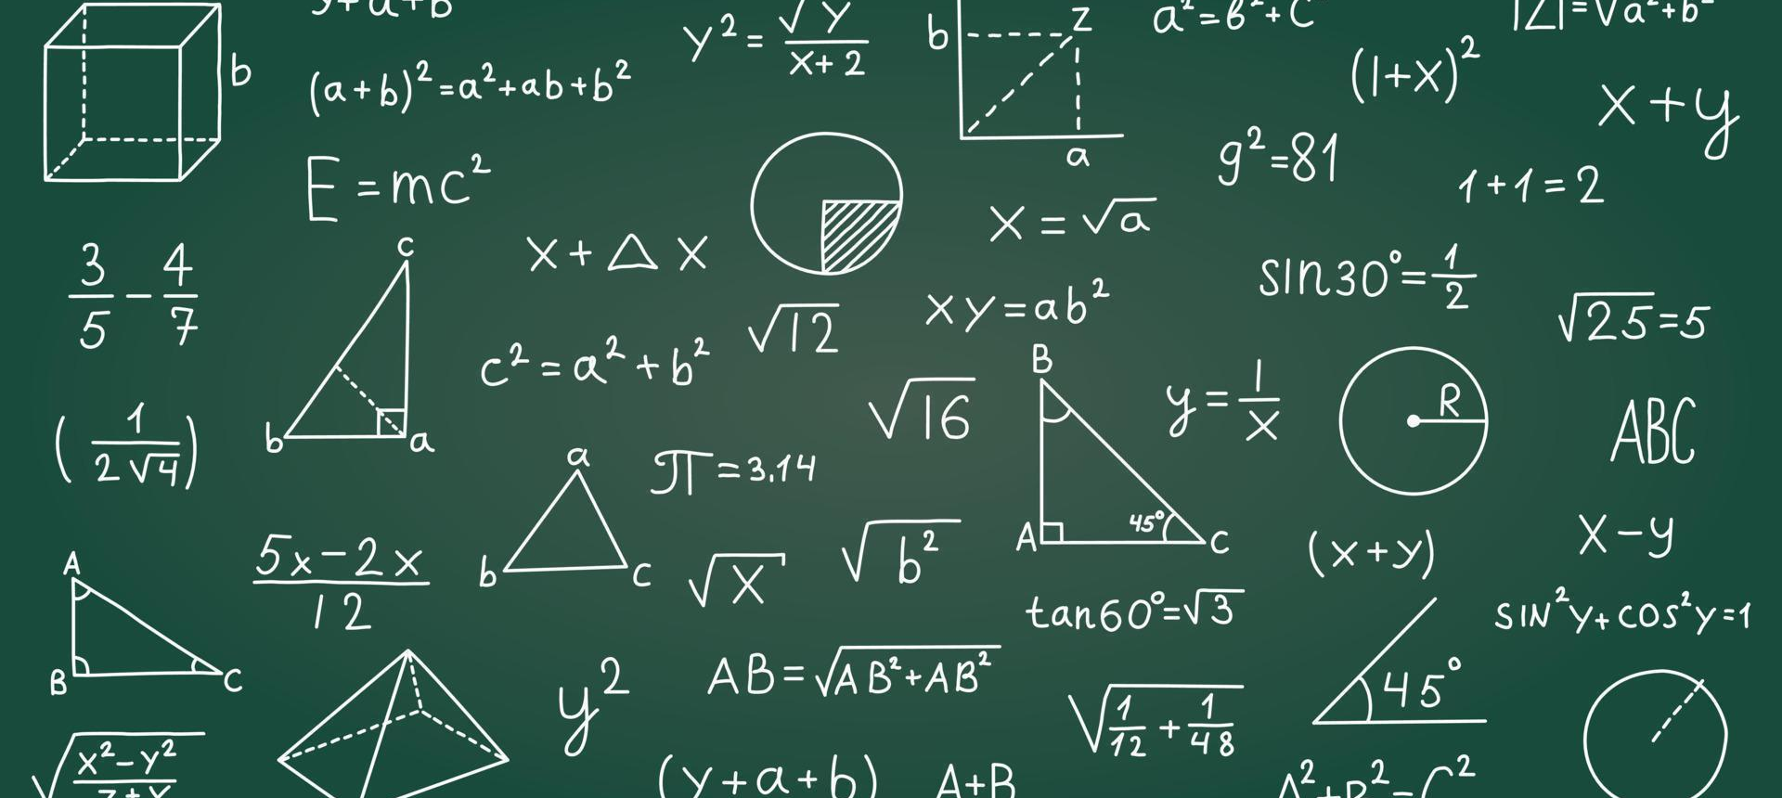
Math Section
2025

Slide 5
[date or practice test #]
Question #_
Question Description:
My Answer:
Correct Answer:
Skill:
Why I Got It Wrong and Explain Correct Answer:

